Slide 1
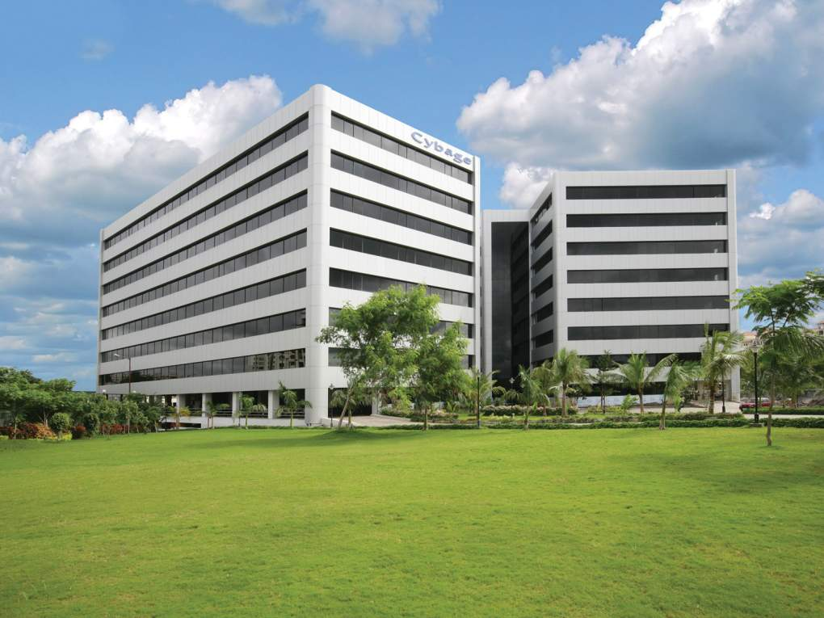

Application Lifecycle Management

Slide 2
Agenda
Definition
Cybage ALM vision
ALM – Technology streams
ALM tools integration
Common ALM tools
ALM implementation stages
Docker ecosystem for DevOps
ALM competency
ALM teams
Benefits of ALM
2

Slide 3
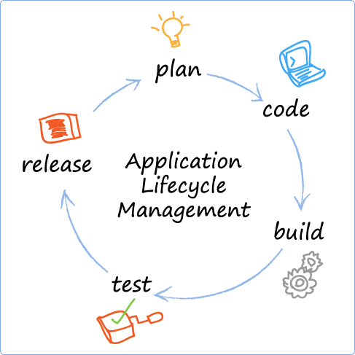
Definition
Application Lifecycle Management (ALM) is a continuous process of managing the life of an application through governance, development, and maintenance.
It encompasses requirements management, architecture and design, development and testing, maintenance, change management, continuous integration, project management, and release management of all phases.
3

Slide 4






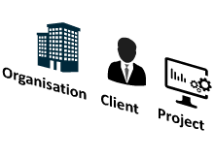

Cybage ALM vision
ALM entities, stakeholders, and benefits
Monitoring
Testing
Deployment & Release
Development
Design
Tools
Requirement Analysis
Project Management
Skills
Governance
Processes
4

Slide 5
ALM – Technology streams
ALM streams
For projects using Microsoft technology
For projects using Java or LAMP technologies
Microsoft (TFS)
Atlassian tools
5

Slide 6


















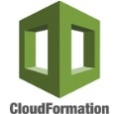



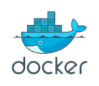
ALM tools integration
Following depicts the most commonly used ALM Atlassian tools.
Requirements management
Project management
Development
Continuous integration
Testing
SCM
Repository management
Build tool
SCA
Artifacts
management
or
or
CI Server
ANT
or
or
or
or
or
or
DevOps
DevOps
Configuration management
Cloud provider
Containerization
or
or
6

Slide 7
Common ALM tools
Phase | Purpose | Tool
Project management | Issue tracking, Release management | Atlassian Jira
 |  | Atlassian Jira Agile
Requirement management | Documentation, Requirements gathering | Atlassian Confluence
Development | Source code versioning | SVN
 |  | GIT
 | Repository management | Fisheye-Crucible
 |  | Github
 |  | Bitbucket
Testing | Test case management | Zephyr
 |  | Test Link
Phase | Purpose | Tool
Continuous Integration (CI) | Build process | Apache ANT
 |  | Apache Maven (JAVA)
 |  | Gulp (JS, LAMP)
 | Unit testing | PHP-Unit (LAMP)
 |  | JUnit(JAVA)
 |  | Mocha (JS)
 | Code coverage | Clover
 |  | Cobertura
 |  | Istanbul(JS)
 | Static code analysis | SonarQube
 | Continuous Integration Server | Jenkins
 |  | Bamboo
 | Binary Repository Manager | Sonatype Nexus
 |  | Jfrog Artifactory
DevOps | Configuration management | Chef
 |  | Ansible
 | Cloud provider | AWS
 | Containerization | Docker
7

Slide 8
ALM implementation stages
Ownership – The ALM team
Ownership – The Delivery team
1 week
2-3 weeks
2-3 weeks
5-6 weeks
1 week - ongoing
ALM
awareness
ALM
gap assessment
ALM
solution proposal
ALM
implementation
Post implementation support and audits
ALM presentation
ALM demo to stakeholders
Understand the workflow
Analyze gaps
Identify RnD or POC
Recommend end-to-end solution with integration
Implementation
Training to the team
Handholding
Sign-off
Gathering reports
Support
Stakeholders-the Delivery team
Stakeholders-the ALM team
8

Slide 9
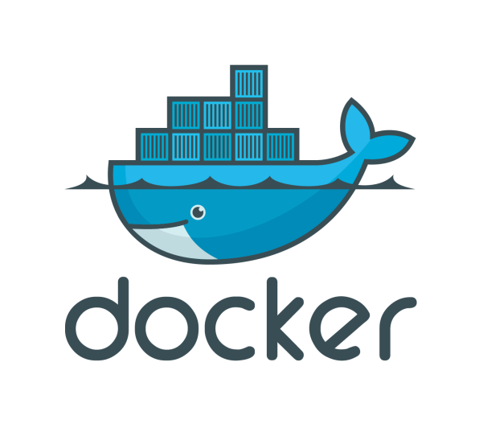
Docker ecosystem for DevOps
Docker is a platform for developers and sys-admins to build, ship, and run distributed applications anywhere.
Docker Orchestration tools
Scheduler and Executor
Docker – CAAS
Machine
Engine
Compose
Swarm
Swarm
Mesos
Kubernetes
Rancher
IBM Bluemix
Docker tools
Marathon
Chronos
Jenkins
Docker Hub
AWS ECR
AWS ECS
Azure
Docker registry
Docker on Cloud
RancherOS
CoreOS
Docker OS
Weave
Consul
etcd
Eureka
cAdvisor
Sysdig
Ruxit
Flocker
Convoy
Docker networking
Service discovery
Docker monitoring
Docker stateful
9

Slide 10
ALM competency
 | Java, Lamp, JS |  | Java | PHP | JS
General | CROWD (single sign-on), Hipchat (communication)
Project management | Jira, Jira Agile
Requirement analysis | Confluence
Source code management | Git, SVN
Repository management and code review | Bitbucket, Fisheye-Crucible, Github, Gitlab
Build process |  | Ant, Maven, Gradle |  | Ant, Phing, Grunt, Gulp | Grunt, Gulp
Unit testing |  | Junit, TesTNG, Mockitos |  | PHPUnit | Mocha-chai
Code coverage | Emma | Cobertura, Clover, JaCoCo |  | Clover | Cobertura, Istanbul
Static code analysis | SonarQube | PMD, Checkstyle,Findbugs |  | PHPMD, PHPCPD, PHPCS | JSHint, JSLint
10

Slide 11
ALM competency – (contd.)
 | Java, Lamp, JS |  | Java |  | PHP | JS
Test-case management | Zephyr, Zephyr JIRA, Test Link
CI Server | Jenkins, Bamboo
Binary Repository manager | Nexus, Artifactory
UI testing |  | Selenium |  |  |  | NightWatch
Stress testing | JMeter, Gatling
Configuration management | Chef, Puppet, Ansible, Saltstack
DevOps | AWS Code Commit, AWS Code Deploy, AWS Code Pipeline, AWS ECS, Codeship with AWS, Cloudbees Jenkins Enterprise, Vagrant, Digital Ocean, JIRA-ServiceDesk, Glusterfs, Kafka, HA Proxy, Bunyan
Profiling |  | JProfiler |  | Xdebug, Blackfire
Continuous monitoring | ELK, Nagios, New relic
11

Slide 12
ALM teams
ALM team
PM - Microsoft (TFS)
PMs – Licensed tools (Open-source and Atlassian)
Technical Architect
RA – Lead
Development
…till
Release
R & D Lead- Vertical1
R & D Lead- Vertical2
…
R & D Lead- Vertical 8
RA - Engineer
…..
Lead
ALM members
DevOps members
12

Slide 13
Benefits of ALM
Speed and agility
Efficiency
Quality
13

Slide 14
Thank you

